Slide 1
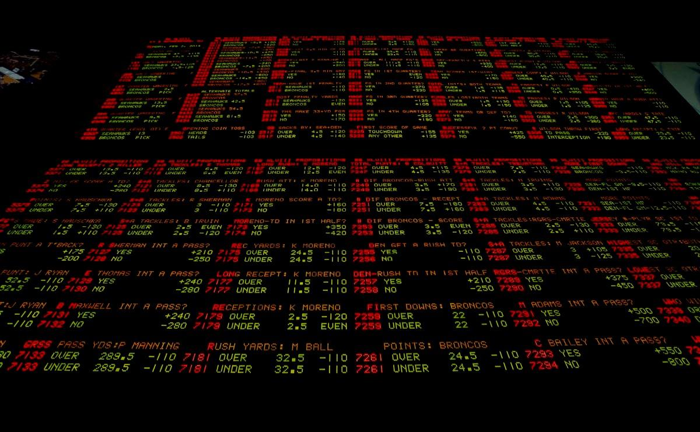
Sports betting trainer
Project:
by Team from AMI-32 (ПМІ-32)

Slide 2


Our team:
Nadiia Hurska
Volodymyr Milchanovskyi
Oksana Pylypovych
Vitalii Pystun
Marta Shuiak

Slide 3


Goal ?
For whom ?
To create a sports betting trainer and analyser
For everyone who would like to try himself in sports betting without losing a lot of money

Slide 4

Technologies planned to be used:
WPF
.Net (C#)
REST API
PostgreSQL

Slide 5





Similar tools analysis:
Functionality
Authorization | + | + | + | + | +
Searching tool | + | - | + | + | +
Saving favourites | + | - | - | - | +
Ability to bet | + | + | + | + | +
Betting statistics | + | + | + | + | +
Results analysis | + | + | + | + | +
Balance replenishment | + | + | + | + | +
Blog | - | + | + | - | -

Slide 6

Functionality of our application:
Searching tool
Ability to bet
Your betting statistics
Results statistics
Virtual balance replenishment

Slide 7
Thanks for your attention !!!
; )
by Team from AMI-32 (ПМІ-32)

